Slide 1

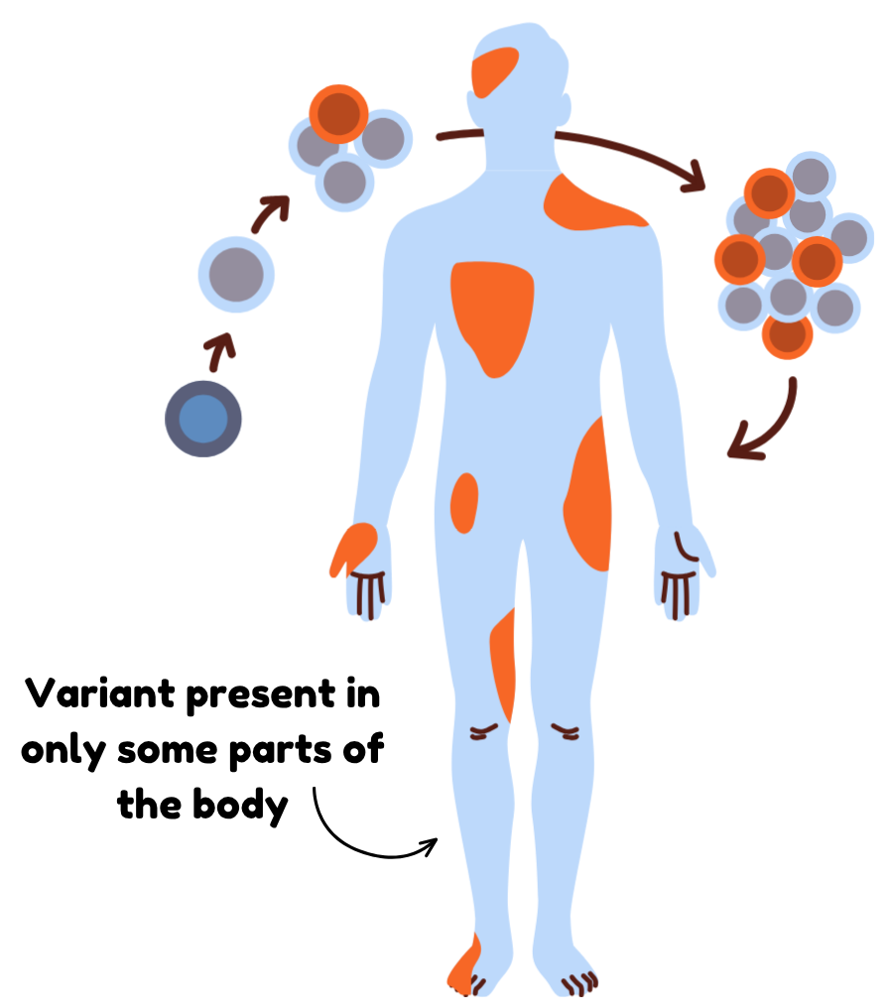
Mosaic Variants
A genetic change that is present in only some cells, is called a mosaic variant
Mosaic variants present in some cells in the pancreas, can cause congenital HI
Mosaic variants have been reported in genes like GCK, HK1,GLUD1, KMT2D, KDM6A, and ABCC8
Extra-pancreatic features associated with some forms of HI will only occur if the mosaic variant is in the relevant tissue (e.g. hyperammonaemia a kidney phenotype associated with GLUD1-HI).
HIGenes Slide Library: Last Updated 06/08/2026

Slide 2
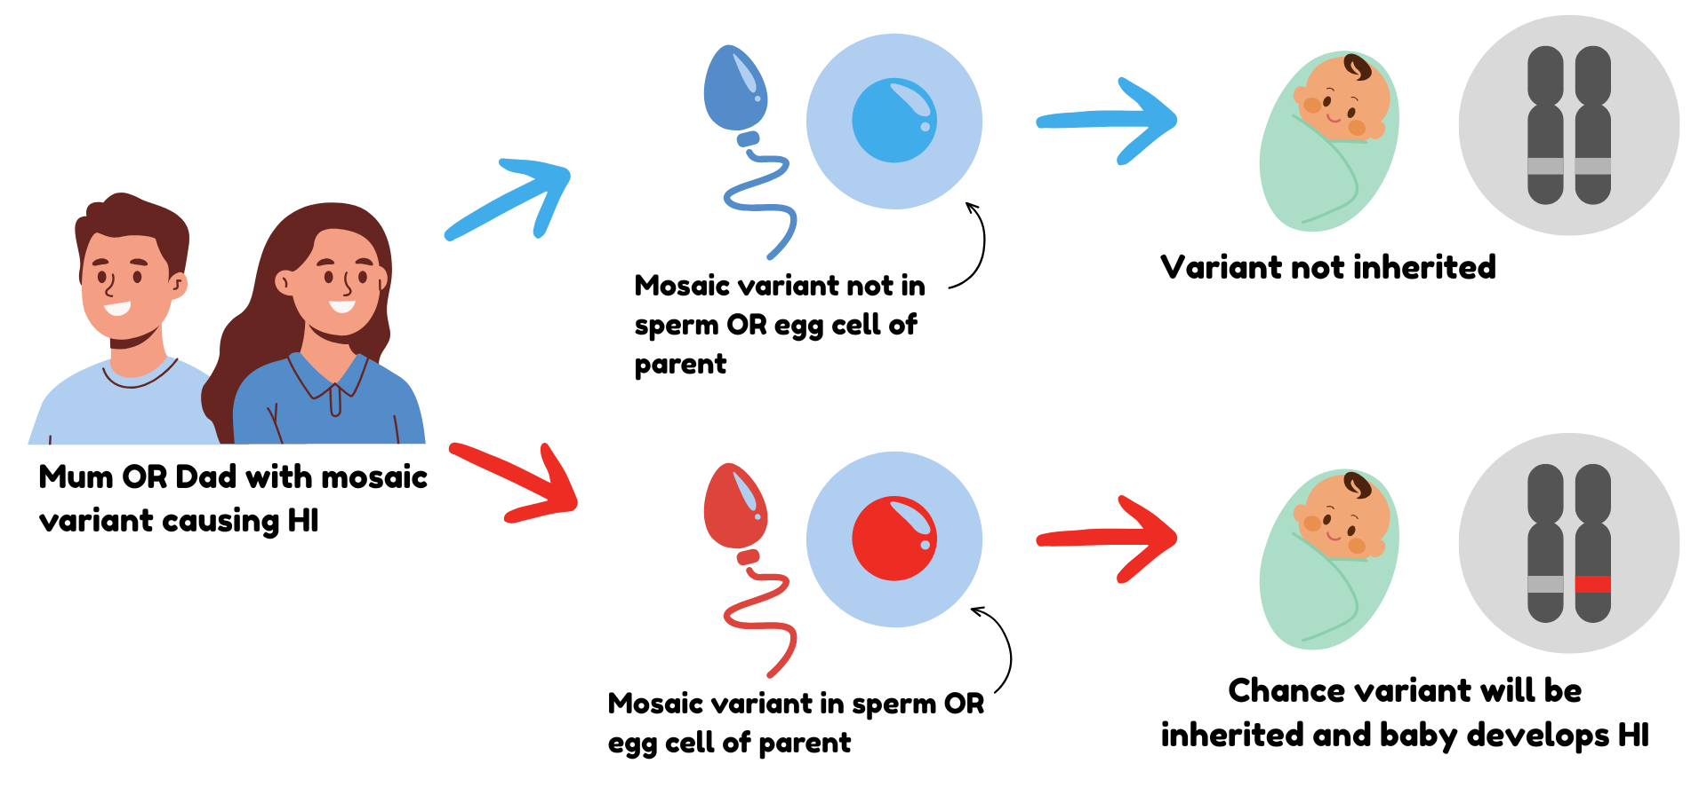
Inheritance of Mosaic Variants
HIGenes Slide Library: Last Updated 06/08/2026

